Slide 1
Employee Management System

Slide 2
Presented by:
Presented to:
Naim Miah
Wahia Tasnim
BCc in CSE
ID: 221902340
Lecturer
Green University of Bangladesh

Slide 3
Table of contents
01
02
03
04
05
06
Introduction & Motivation
Methodology
Diagram
Implementation
Demonstration
Conclusion

Slide 4
01
Introduction & Motivation

Slide 5
An employee management system completely changes how companies manage their employees, combining data, automating tasks, and giving employees more control for smoother operations.
Efficiency Boost
Enhanced Collaboration
Insightful Decision-Making
Employee Empowerment

Slide 6
02
Methodology

Slide 7

Front End & Back End
For implementing this project we use:
HTML
CSS
MySQL
PHP

Slide 8
03
Diagram

Slide 9
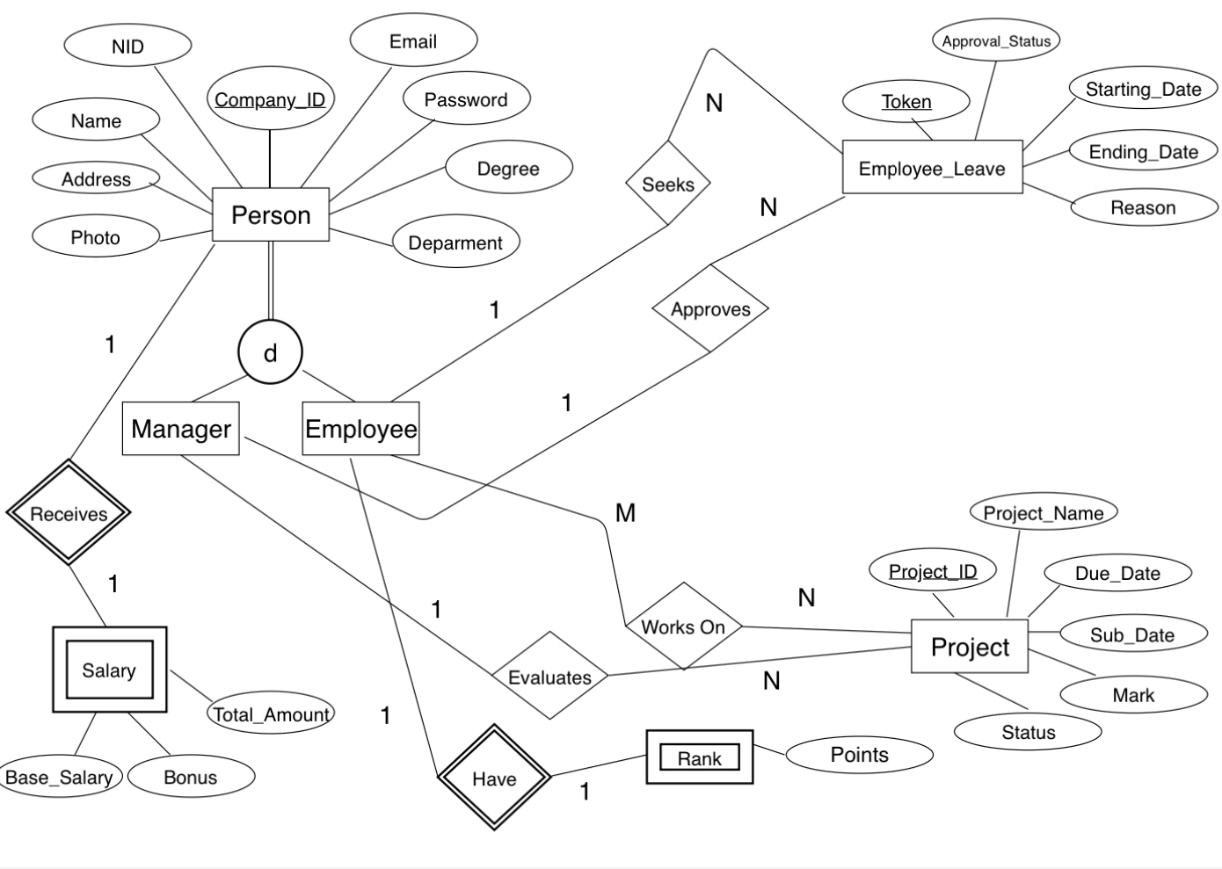
ER-Diagram

Slide 10
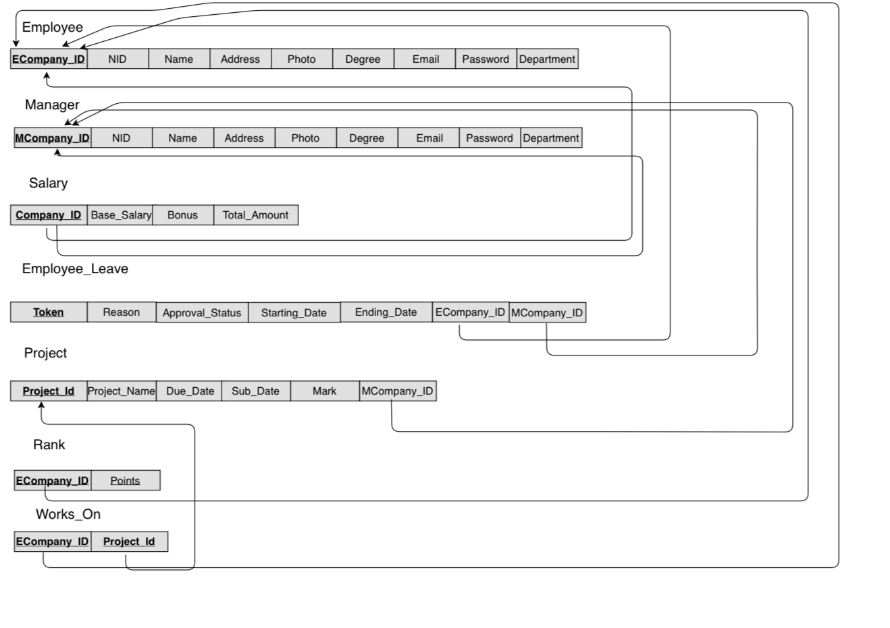
Relational Schema

Slide 11
04
Implementation

Slide 12
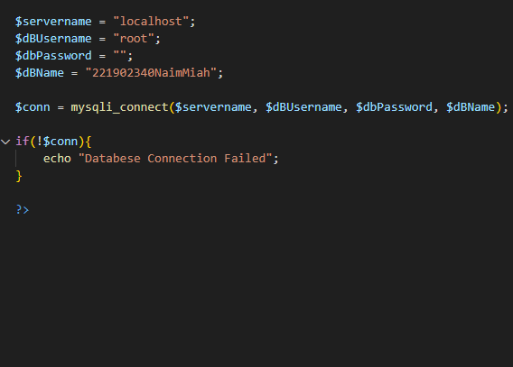
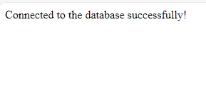
Database Connection

Slide 13

Overview of Home page

Slide 14
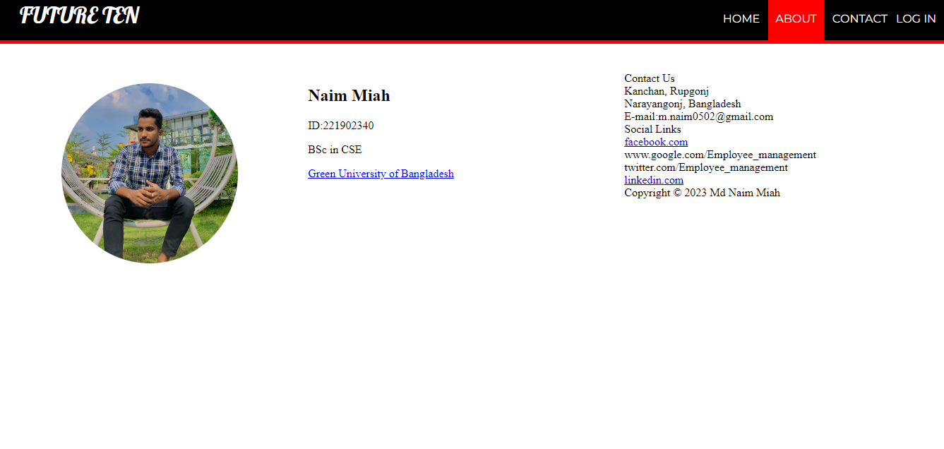
Overview of About Section

Slide 15
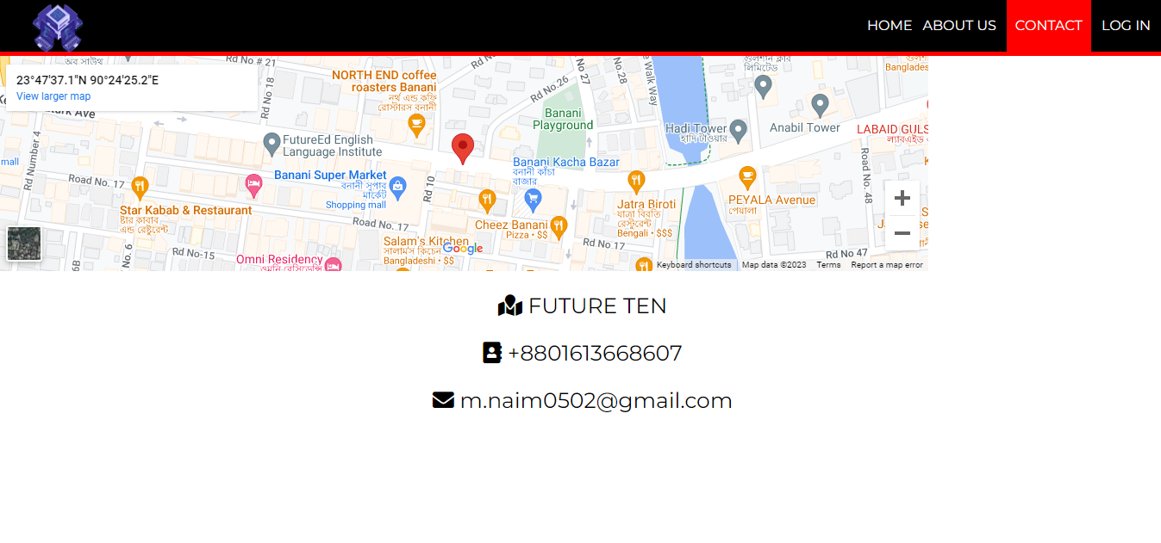
Overview of Contact Section

Slide 16
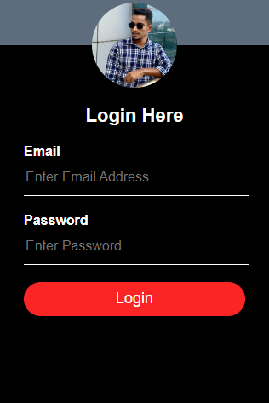
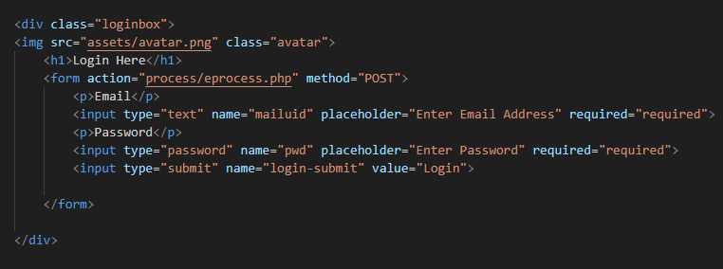
Login Panel

Slide 17
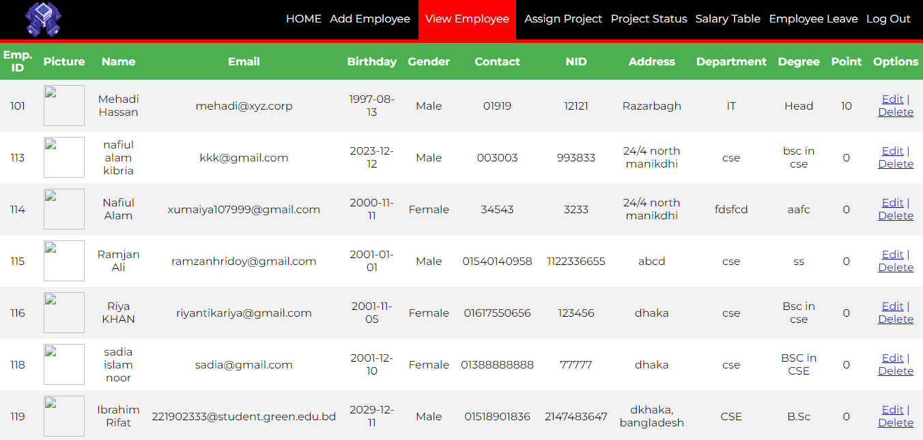
Overview of Admin Panel

Slide 18
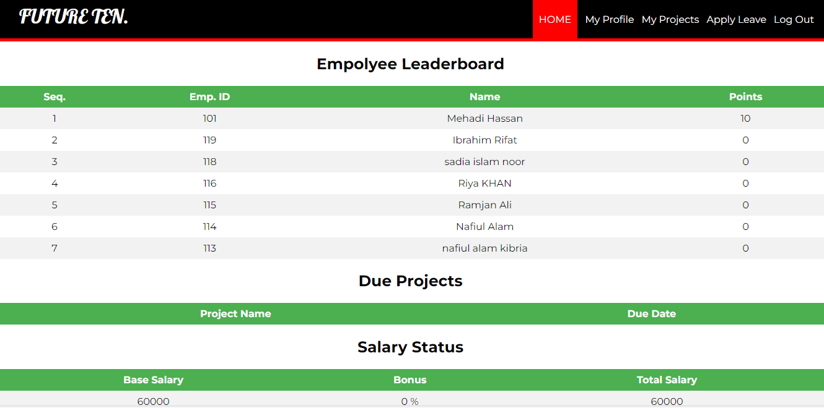
Overview of Employiee Pannel

Slide 19
05
Demonstration

Slide 20
06
Conclusion

Slide 21
Future scope
The future scope of an Employee Management System project utilizing MySQL could encompass several advancements and expansions:
Mobile Optimization
Globalization and Localization
AI and Predictive Analytics Integration
Advanced Reporting and Visualization

Slide 22
Summary
Efficiently centralize HR data with MySQL, ensuring security, user-friendliness, and future readiness for evolving workplace needs.
Data Centralization
Security Measures
User-Friendly Interface
Efficient
Mobile Accessibility
Employee Empowerment

Slide 23


Slide 24
Thanks!

